Slide 1
IMA Workshop
New approaches to teaching mathematical sciences
“towards a problem based-learning curriculum”
Kevin Golden
Acting HOD
Engineering Design and Mathematics, UWE
Date 21st March 2018

Slide 2
Structure
Some PBL / PjBL concepts
Integrated Learning Project
Field Work
Can this work for mathematical sciences?

Slide 3
EDM Integrated Learning Programme
Curriculum change project for 2020 – 21
Coincide with new accommodation
For Engineering disciplines and mathematical sciences
  Mathematical sciences
  Mechanical and automotive engineering
  Electronic engineering and robotics
  Aerospace engineering

Slide 4
What are we trying to achieve ?
Promote high level student engagement and achievement through design of our programmes and governance.
Integrate
  Subject knowledge
  Academic Practice
  Professional Environment
  Personal Development
Prepare our graduates for a competitive environment – new technology – entrepreneurial
Delivery and assessment to based on programmatic objectives
Provision to embed PBL or PjBL principles.
Student centred delivery, assessment and governance
Exploit the strengths of our industrial partners and research

Slide 5
Some PBL concepts – taken from Aalborg (AAU)
PBL – problem based learning PjBL – project based learning
The problem is the starting point directing the student’s learning process. A problem can be both theoretical and practical.
A problem must be authentic (currency outside of academic environment) and scientifically based (can be subjected to systematic enquiry).
A project represents a time limited and targeted process in which a problem may be phrased, analysed and solved, resulting in a tangible product.
The learning is student centred
Students must be trusted to manage their learning

Slide 6
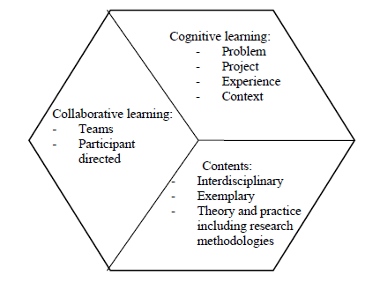
Characteristics of PBL approach
(Kolmos – AAU)

Slide 7
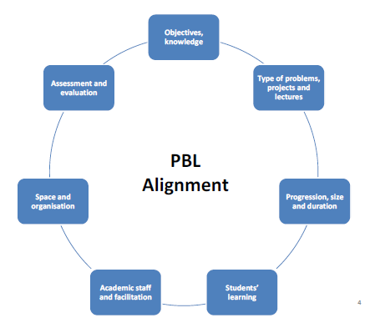
The approach must be aligned
(Kolmos – AAU)

Slide 8
PBL
Student directed
Projects
Closed
problems
Courses
Open
problems
Teacher directed

Slide 9
A simple “open” problem – Can optimisation Foundation Group Project at UWE
In preparation for this task you were asked to look at an investigation of this problem. http://datagenetics.com/blog/august12014/index.html
What were the author’s conclusions
What did the evidence show?
Do manufacturers try to minimise the amount of material in can manufacture or were there other considerations to be taken into account.
What were these other considerations ?
Were there any assumptions in the model that was developed and did these assumptions influence the conclusions?

Slide 10
Organisation - multidisciplinary
maths sciences
robotics
mechanical
aerospace
automotive
electronics
Foundation Year students
One hour lecture + 2 hour workshop (TEAL room)
Students provided with basic solution in lecture
Students organised in to multi-disciplinary groups
Must work to improve the solution – make the solution more realistic
Research / critical thinking

Slide 11
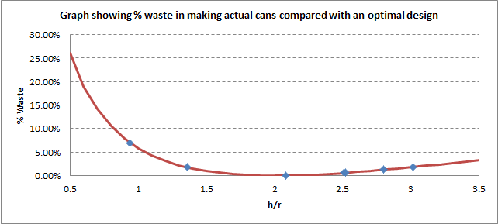

Slide 12
Field work – some good examples for engineering but can this work for mathematical sciences?

Slide 13
Aalborg University Denmark - AAU
Background
  Established in 1970’s – Reform movement of Universities
  Not selective (beyond technical requirements – maths, etc)
  All provision is PBL based
  Projects at heart of delivery
  Student centred
  Engineering curriculum uses industrial examples / clients (maths less so)
  Now one of the top Universities globally
Structure of provision
  Most students on Bologna 3 + 2 model (UG + Masters)
  2 x 15 week semesters
  Each semester 3 x 15 credit taught modules + 1 x 30 credit project module
  All UG projects are group projects (6 students)
  Group reports are not marked. Assessment is by oral examination and produces individual marks
  Projects are student centred and student led

Slide 14
AUU Project Module
Lectures
Literature
Group studies
Problem
Analysis
Problem
Solving
Project
Assessment
Tutorials
Experiments
Field Work

Slide 15
Aalborg University Denmark – AAU – students describing their learning
  Team work
  Applied and relevant
  Learning how to learn
  Responsibility
Yes – they did provide us with perfect students !

Slide 16
UCL
Background
  Russell Group University
  Highly selective – A/A* maths entry – though no longer require physics for engineering
  Integrated Engineering Programme (IEP)
  Strong Mission – Engineers change the world !
  Align provision with mission
  Operating for 4 years
Structure of provision
  IEP applied across engineering programmes
  30 to 45 credits of project / personal development
  Applied to all years
  Projects are not necessarily industry based
  Many projects based on “Grand Challenges” “Change the world challenges
  Programmes free to organise remaining provision as they wish
  Group projects (4 students)
  Group work for the most part produces group marks
  Project weeks used to create “event”.

Slide 17
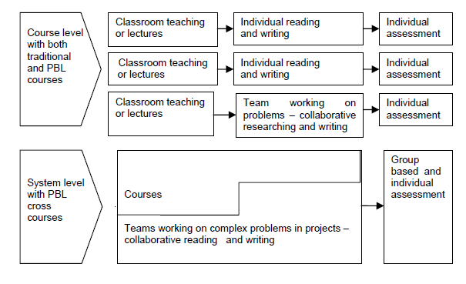
Curriculum design (Kolmos – AAU)

Slide 18
What do we already ?
Our students complete many assessed projects
Projects are individual and group
We use TEAL rooms (2 - 3 years experience)
We use (some) flipped classes (3 to 4 years experience)
We have a long established flexible e-assessment platform (DEWIS)
We are about have new accommodation, with student social learning space at the heart of the design

Slide 19
Examples of assessed projects for our mathematical sciences students
Level 0: Group, multidisciplinary – calculus, curve fitting, simple numerical methods, excel
  Traffic flow modelling
  Sky diver simulation
  Bloodhound land speed record simulation
Level 1: Group – differential equations/numerical methods
  Phoebe Rocket – human cannonball
  Fishing lake design
  Temperature control of buildings
Level 2: Group – differential equations, linear algebra, numerical methods
  Frequency of aftershocks following earthquakes
  Water pollution
  Climate modelling
Level 2: Individual – probability distributions
  Crowd control queuing at festivals
Level 3: Individual 0 professional practice statistician
  Large (messy) data sets, missing data, advice to clinicians
  Randomised medical trials – linked to funding bid scenario

Slide 20
Where is the problem ? And there are problems …
Student engagement variable
Placement year (evidence of decline)
Tight modular structure constrains the curriculum and assessment
Students are highly focussed on assessment, but does this lead to the development of skills, knowledge, understanding
Awareness of future professional environment

Slide 21
Integrated Learning structure – first steps
TB1 12 weeks
TB2 12 weeks
START WEEK - Induction
YEAR 0
CONTROLLED ASSESSMENT
CONTROLLED ASSESSMENT
PROJECT WEEK
PROJECT WEEK
YEAR 1
YEAR 2
YEAR 3
YEAR 4
?? credits
120 - ?? credits

Slide 22
Summing-up
The practice at UWE is not unique. I’m aware of many similar examples of project style – application focussed assessments at other departments of mathematical sciences at post 92 and Russell group institutions
Our aim is to move to a more stu, dent centred curriculum design?
We need to prepare mathematical science graduates for a rapidly changing and competitive environment
Review the balance between subject knowledge, academic practice, professional environment and personal development.
After all, our main accrediting body is The Institute of Mathematics and its Applications
The approach will inevitably be one of reflection and evolution

